Slide 1
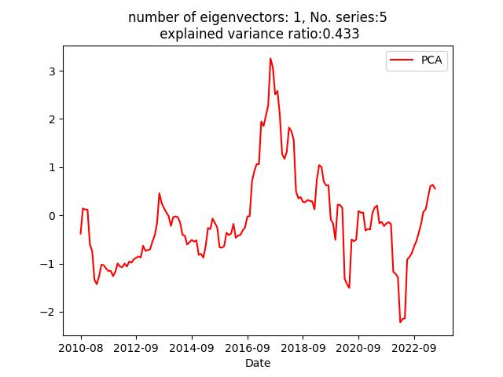
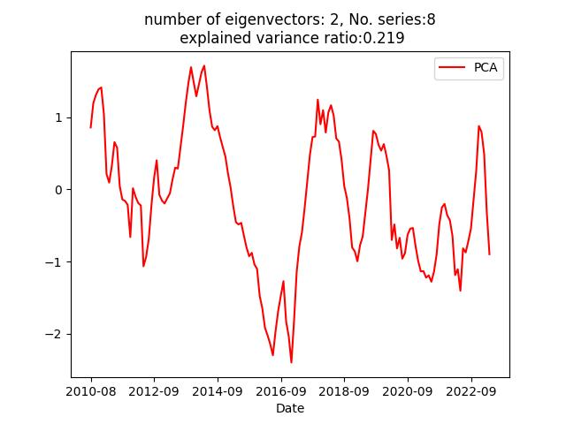
Egypt PCA results
Risk_Premium : -0.4380600195757135
Stock_Prices_mom%_change : -0.057834643149044074
Stock_Prices_mom24mma%_change : -0.37514923731223115
Current_Account_Balance_over_GDP : -0.6110289341130871
Policy_Rate_&_Fed_Funds_Rate_Differential_AVG : -0.056111551809737176
Foreign_Exchange_Reserve_change_yryr% : -0.24304629864834498
Portfolio_Flows : -0.2469791469642677
Bank_Lending_mo12m%_change : -0.4092023413342972
Term_Premium : 0.18895313118061396
Stock_Prices_mom%_change : 0.16351687576812912
One-Day_Repo_Rate_AVG : 0.5530146036193895
Foreign_Exchange_Reserve_change_yryr% : 0.5943155571274518
Portfolio_Flows : 0.5277526052006261

Slide 2
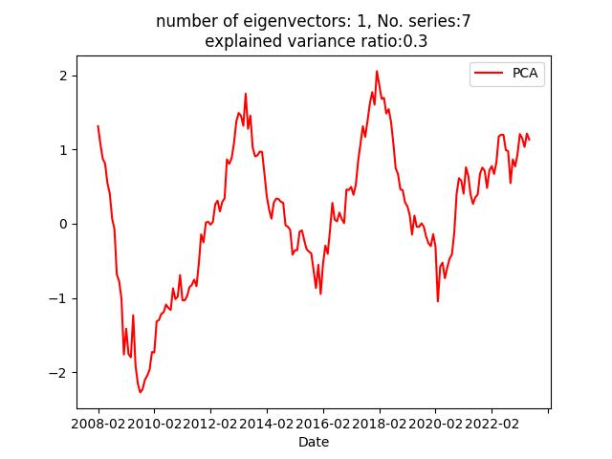
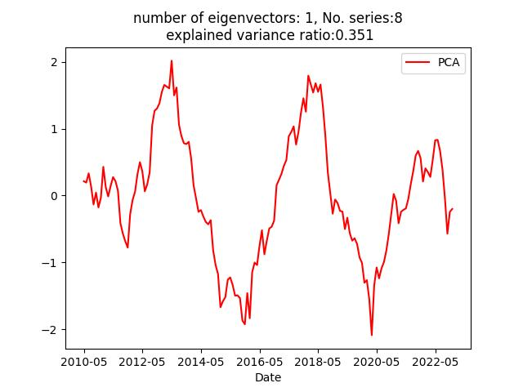
Nigeria PCA results
Term_Premium : -0.19241188109402058
Stock_Prices_mom%_change : -0.25114716161154815
Stock_Prices_mom24mma%_change : -0.47124830252594135
One-Day_Repo_Rate_AVG : -0.01694846609337798
Current_Account_Balance_over_GDP : -0.4714095700071484
Broad_Money_mo12m%_change : -0.28152446128656394
Foreign_Exchange_Reserve_change_yryr% : -0.4666051522133403
Foreign_Exchange_Reserve_over_GDP : -0.39791605273320424
Term_Premium : -0.2752746498139724
Stock_Prices_mom%_change : -0.22035454781884023
Stock_Prices_mom24mma%_change : -0.5581375236512278
Stock_Market_Volatility : -0.10963651990698792
REER : -0.20448636020482341
One-Day_Repo_Rate_EOP : -0.5088552444195341
Foreign_Exchange_Reserve_change_yryr% : -0.5014

Slide 3
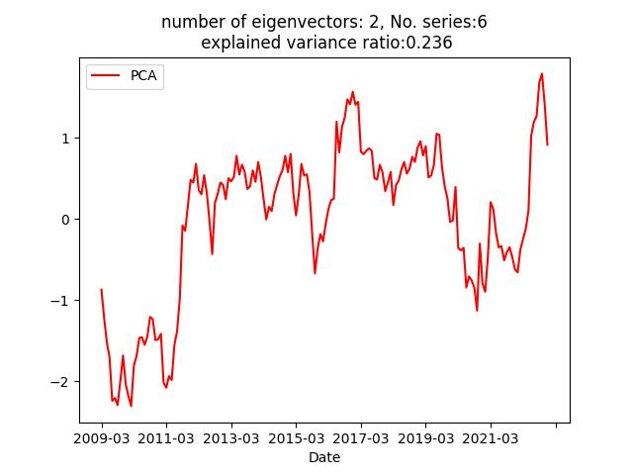
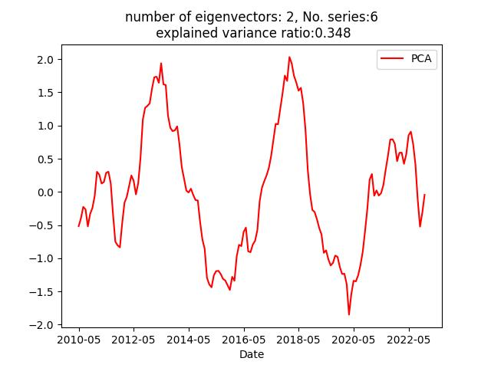
Nigeria PCA results
Term_Premium : -0.4990286178354506
Stock_Prices_mom%_change : -0.026195774297542385
One-Day_Repo_Rate_AVG : -0.7133698761188978
REER : -0.3744644383816228
Current_Account_Balance_change_yryr% : -0.11477140559155019
Broad_Money_mo12m%_change : -0.2966336944488546
Risk_Premium : 0.05733605297208811
Stock_Prices_mom24mma%_change : 0.610187682882014
Policy_Rate_&_Fed_Funds_Rate_Differential_AVG : 0.06429258392685316
One-Day_Repo_Rate_EOP : 0.0658503813375736
Current_Account_Balance_over_GDP : 0.5342528152235849
Foreign_Exchange_Reserve_change_yryr% : 0.5748805867691478

Slide 4
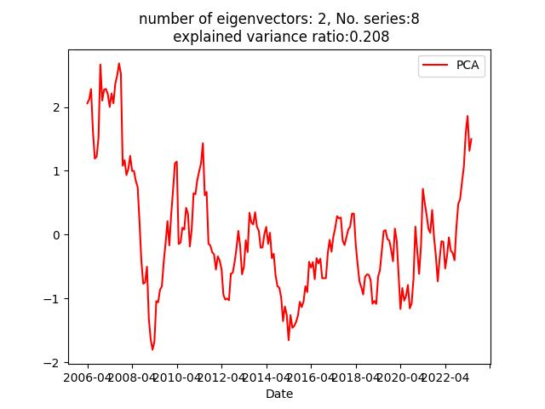
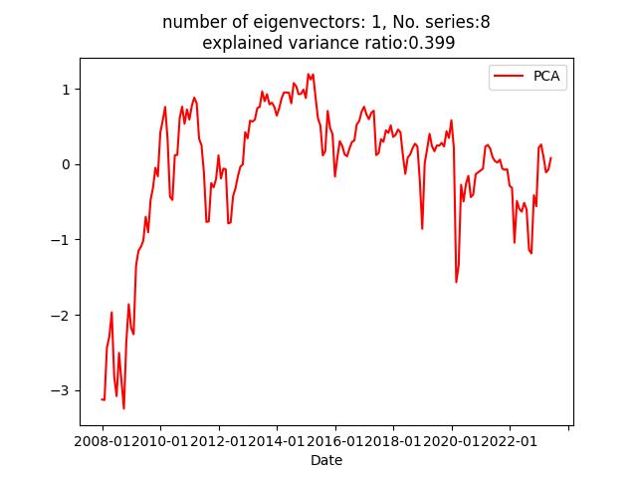
Romania PCA results
Risk_Premium : -0.03183725385267116
Stock_Prices_mom24mma%_change : -0.33781256012798927
One-Day_Repo_Rate_AVG : -0.3842806179640608
Current_Account_Balance_change_yryr% : -0.1745916588
Broad_Money_mo12m%_change : -0.1749750009934459
Foreign_Exchange_Reserve_change_yryr% : -0.719352205
Portfolio_Flows : -0.07309416916364918
Velocity_of_Money_mo12m%_change : -0.3915209053839487
Risk_Premium : -0.3352430852615103
Stock_Prices_mom%_change : -0.2488454420336922
Stock_Prices_mom24mma%_change : -0.44695181907690806
Stock_Market_Volatility : -0.39166806499552675
Current_Account_Balance_over_GDP : -0.4537799874743716
Bank_Lending_mo12m%_change : -0.46387822169279475
Portfolio_Flows : -0.14657929340717069
Velocity_of_Money_mo12m%_change : -0.17301285270478245

Slide 5
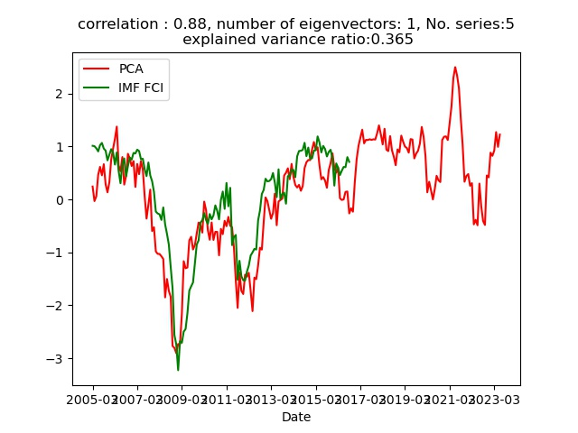
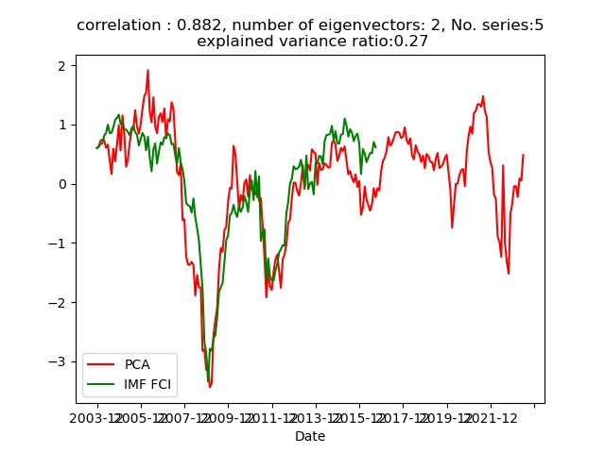
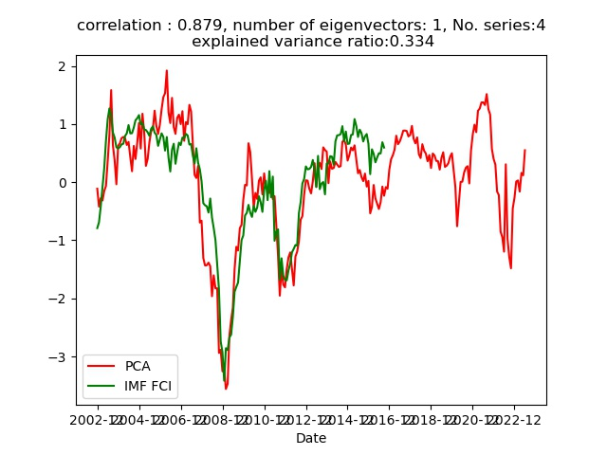

Poland PCA results

